Slide 1

Windows Phone 8: A developers perspective
Adam Steinert
Software Architect
adams@yaharasoftware.com
http://adamsteinert.com
@adamsteinert

Slide 2
Windows Phone 8
Examine the experience
How to get started developing
Dive into some code

Slide 3
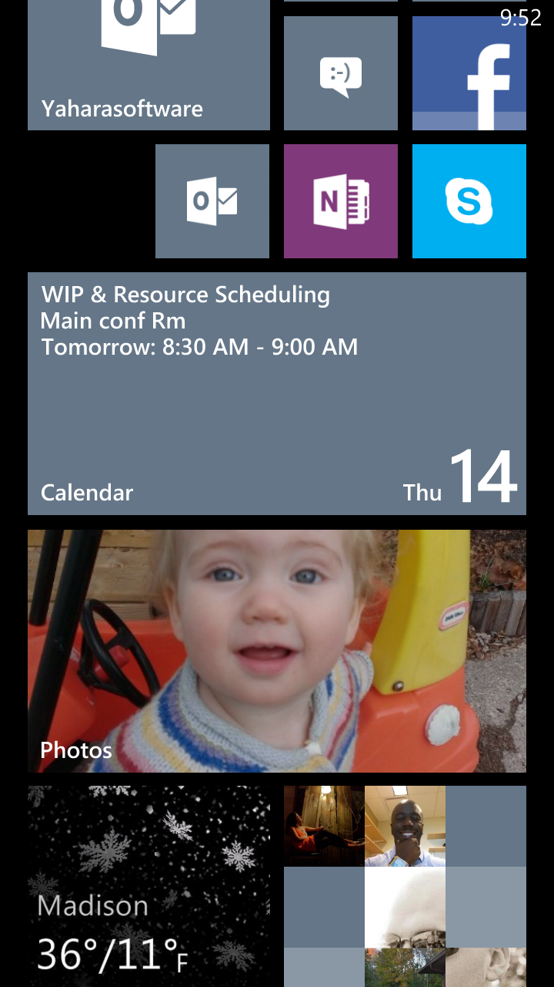
Tiles
Fluid experience
More than just launching apps
Engages and informs the user

Slide 4

Design Philosophy
Typography
More with less
Content over chrome

Slide 5

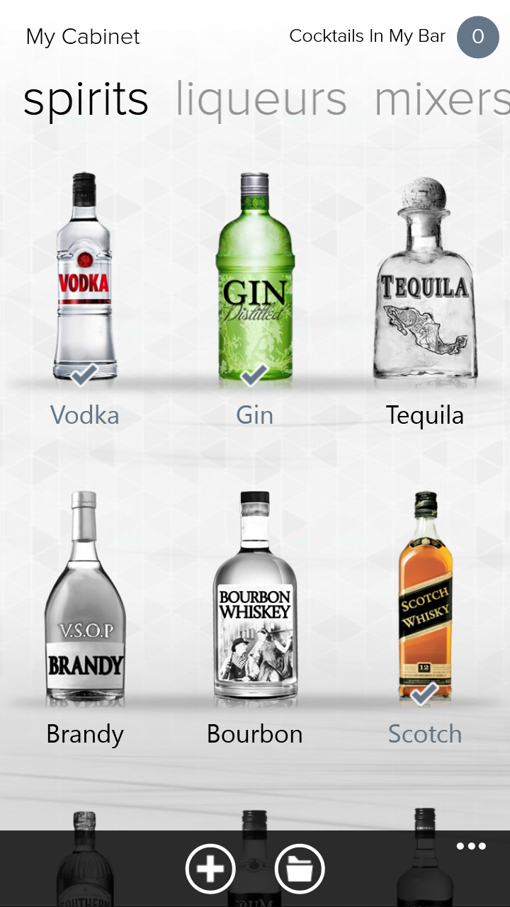


Slide 6
Platform Features
Tiles
&
Notifications
Lock Screen
Data
Wallet
Media
Store
Location
.NET CLR
Speech
Maps
& Navigation

Slide 7
Getting Started
Visual Studio .NET
Windows Phone 8 SDK
Emulator
XAML / C#

Slide 8
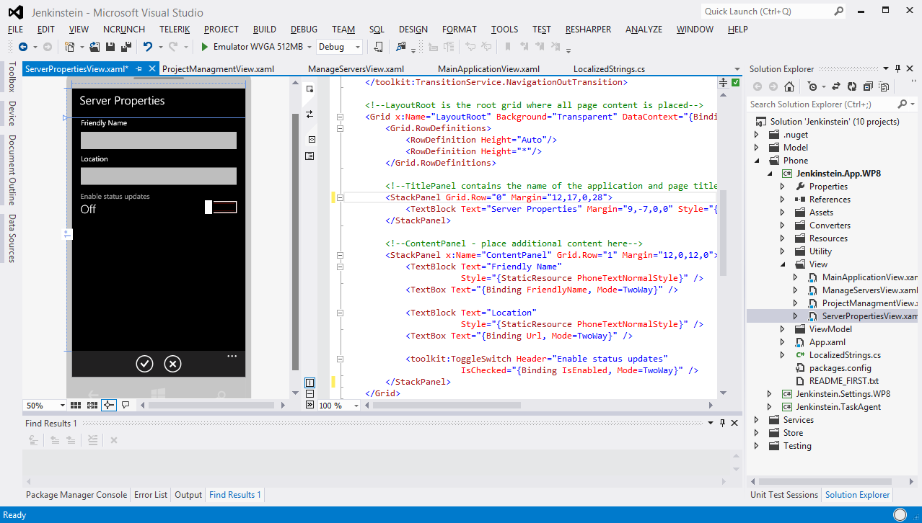

Slide 9
Knowledge Reuse
Phone
Windows RT (Surface/Windows Store)
Desktop Applications
Xamarin

Slide 10
Resources
Visual Studio .NET
www.microsoft.com/express/
Windows Phone 8 SDK
http://dev.windowsphone.com/en-us/
Design Principles
http://dev.windowsphone.com/en-us/design/principles
Registration Fee Reimbursement
http://www.generationapp.com/ultimateexperience

